Slide 1
Human Activity Recognition Progress Report
Harshad Pardeshi Prof Nik Bear Brown
Krutika Deshpande Spring 2018
Prithvi Kamath Northeastern University

Slide 2
Overview of Presentation
Introduction
Dataset
Exploratory Data Analysis
Machine Learning Algorithms
Future work

Slide 3
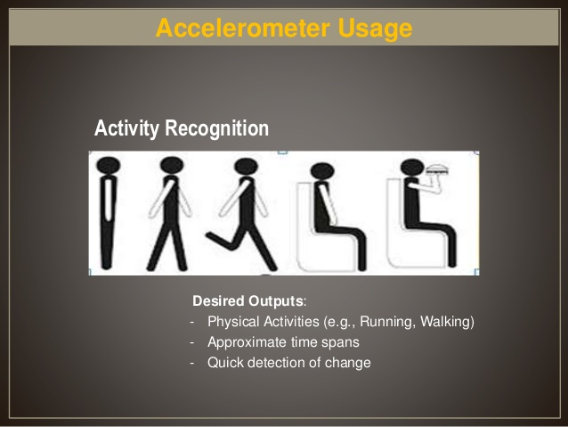
Introduction
Action Recognition is the process of identifying actions that occurs when an object moves(in this case, by humans)
Goal of activity recognition is an automated analysis or interpretation of ongoing events and their context from video data.

Slide 4
Dataset
Body_accerlation
body_acc_x
body_acc_y
body_acc_z
6 activities WALKING, WALKING_UPSTAIRS, WALKING_DOWNSTAIRS, SITTING, STANDING, LAYING for 30 users
128 data points recorded in 2.56 seconds with 50% values carry forwarded
Body_Gyroscope
body_gyro_x
body_gyro_y
body_gyro_z
Total_Acc
total_acc_x
total_acc_y
total_acc_z

Slide 5
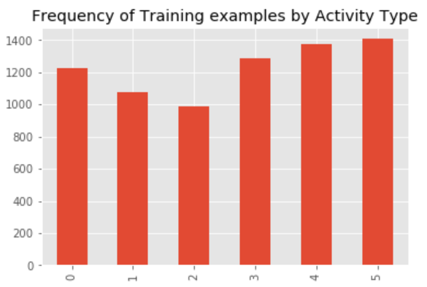
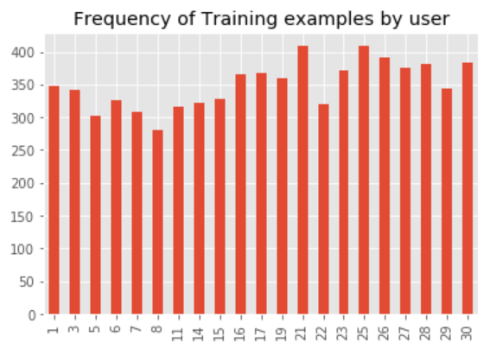
Exploratory data analysis

Slide 6
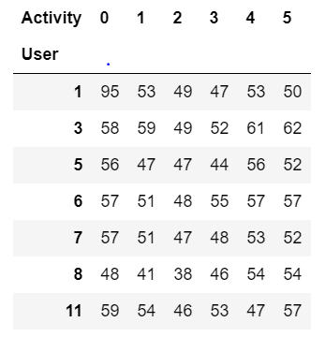
Exploratory data analysis

Slide 7
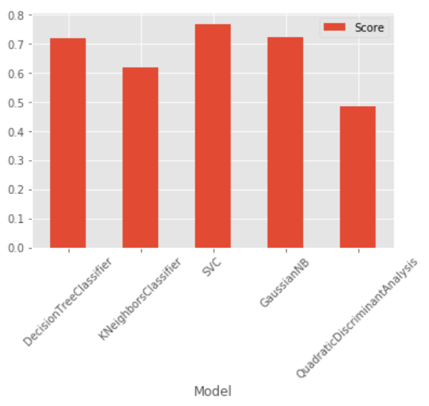
Machine Learning algorithms
Algorithm Name | Accuracy
Decision Tree | 71.97 %
K Nearest Neighbors | 61.89 %
SVC | 76.95 %
Gaussian Naïve Bayes | 72.48 %
Quadratic Discriminant Analysis | 48.45 %

Slide 8
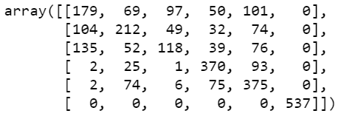
SVC Confusion Matrix

Slide 9
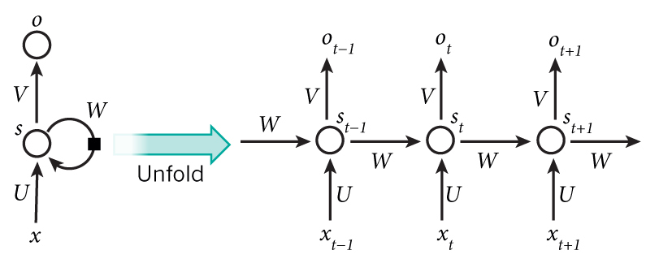
RNN

Slide 10
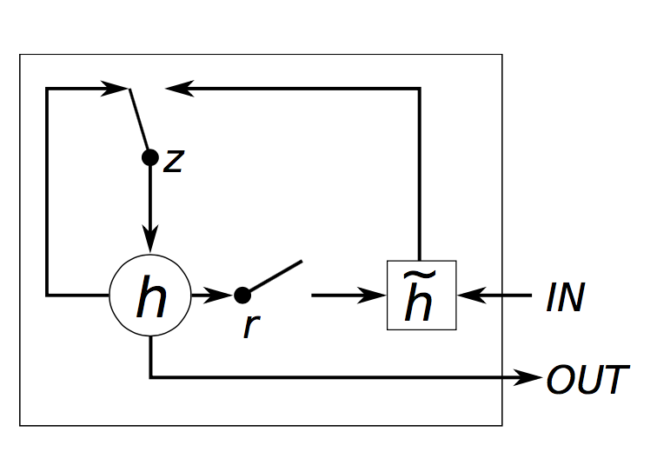
Gated Recurrent Unit (GRU)
Exploratory data analysis

Slide 11
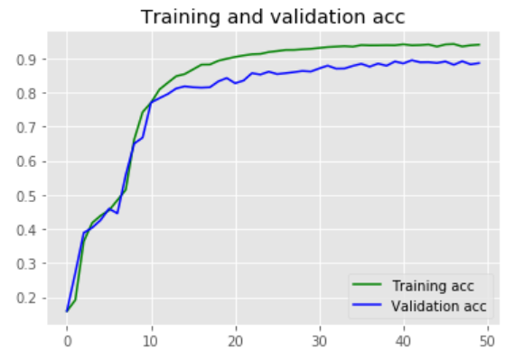
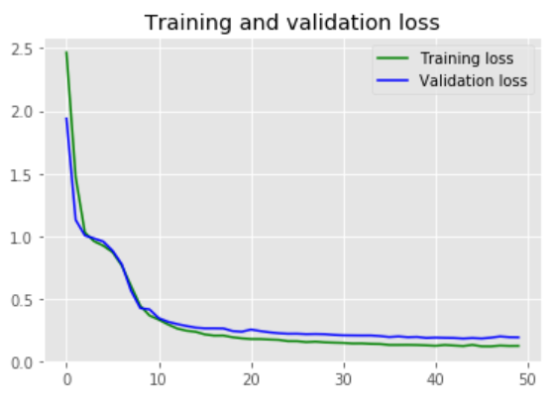
Results

Slide 12
Future Work
Adding more layers to RNN and use of different activation functions
Implementation of LSTM and performance comparison between the two
Develop an Android App to predict the human activity

Slide 13
Thank You

